Slide 1
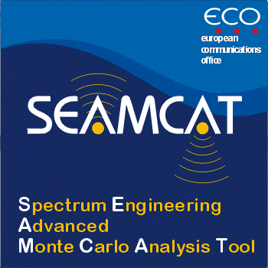
SEAMCAT
European Communications Office
José Carrascosa - SEAMCAT Manager
jose.carrascosa@eco.cept.org
5 April 2016

Slide 2
Presentation outline
Part 1: introduction to SEAMCAT
What does SEAMCAT stand for?
Purpose
History
SEAMCAT in the CEPT context
Who is using SEAMCAT?
Where can I download SEAMCAT?
Where can I find the user manual?
Part 2: introducing SEAMCAT 5
Increased computation speed
Increased flexibility
Increased transparency and reliability

Slide 3
What does SEAMCAT stand for?
Spectrum Engineering Advanced Monte Carlo Analysis Tool

Slide 4
Purpose
SEAMCAT is designed for:
Co-existence studies between different radio systems operating in the same or adjacent frequency bands
Intended mainly (but not exclusively) for systems operating under terrestrial services
Extended to cellular systems based on CDMA and OFDMA
Quantification of probability of interference between radio systems
Not designed for system planning purposes
Based on Monte-Carlo statistical method

Slide 5
History
Developed in CEPT in co-operation between national regulatory administrations, the industry and the ECO
First specified in the late 1990’s and gradually developed ever since
Latest versions:
4.1.0 (October 2013)
5.0.0 (January 2016)
5.0.1 (expected in April 2016)
Version 5.1.0 expected to be released in Autumn 2016

Slide 6
SEAMCAT as a strategic tool for the CEPT
SEAMCAT is :
A software for performing sharing and compatibility studies used in many ECC and CEPT Reports
A Reference tool recognized at ITU
An agreed working platform
Project Teams (PTs) can focus on the input parameters and share their workspaces
Sharing these workspaces increases the trust among stakeholders involved in a particular study
An educating tool for new spectrum engineers for their use in administrations, industry or at Universities.

Slide 7
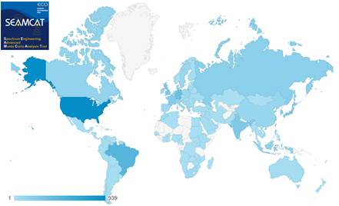
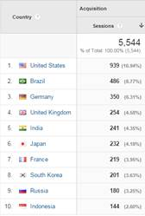
Who is using SEAMCAT?
Source: google analytics on visits to the www.seamcat.org page in 2015.

Slide 8
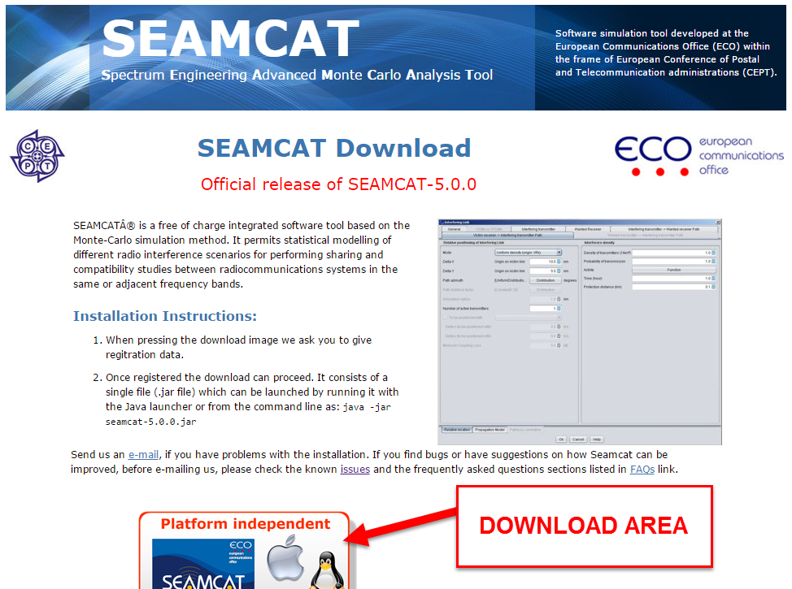
Where can I download SEAMCAT?
SEAMCAT can be downloaded in www.seamcat.org after filling a formular.

Slide 9
SEAMCAT Handbook: over 400 pages of documentation
SEAMCAT handbook reviewed in 2015 in STG and in 2016 during the public consultation of ECC Report 252
Accessible here. (http://www.cept.org/ecc/groups/ecc/wg-se/stg/client/introduction/ )

Slide 10
SEAMCAT 5
Increased computation speed
Increased flexibility
Increased transparency and reliability

Slide 11
Increased computation speed
Introduction of parallel processing, using the full capability of computers with multi-core processors
Code optimization of heavy algorithms, which is a continuous effort in each SEAMCAT release

Slide 12
Increased computation speed
Parallel processing
Using the full capability of computers with multi core processors
Optimization of some known heavy algorithms
CDMA UL default setup with 10 events – An example
Version 4: 100 seconds
Version 5: 22 seconds
Factor 4

Slide 13
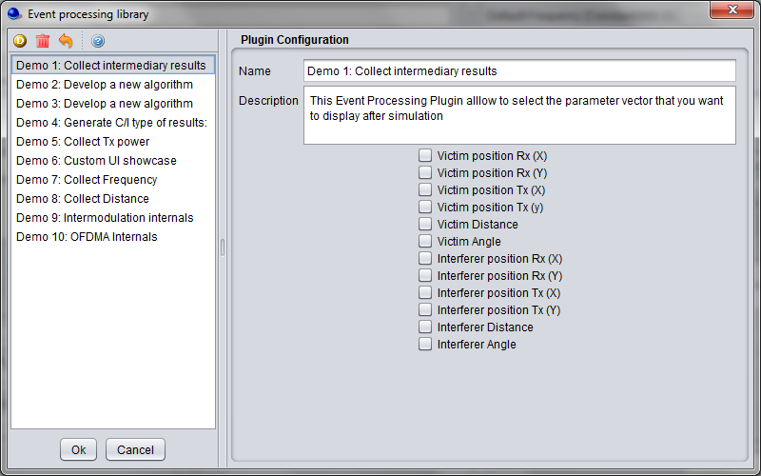
Increased flexibility
Event Processing Plugin (EPP): this new feature allows users to extend SEAMCAT core functionalities by implementing their own algorithms, using the SEAMCAT interface
A growing internal Plugin Library which contains:
Antenna plugins (AP) with pre-defined patterns
Propagation model plugins (PMP)

Slide 14
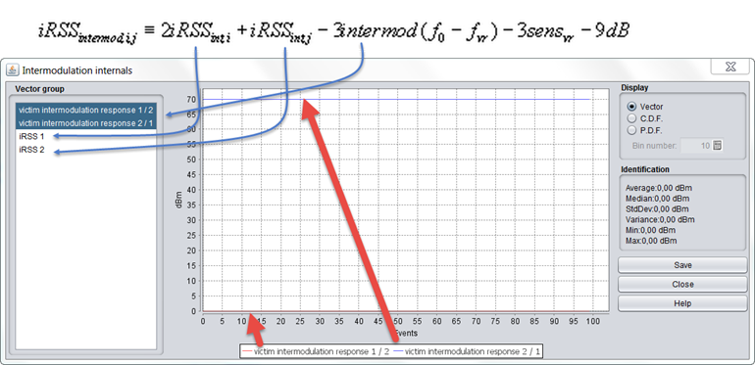
EPP
Extraction of intermediate results
E.g: intermodulation calculation

Slide 15
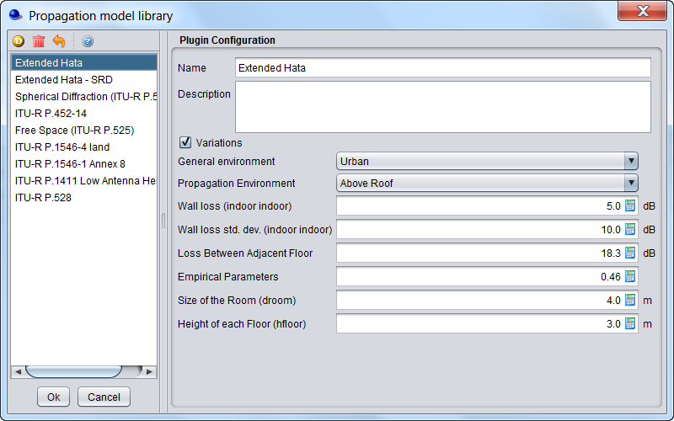
Internal Plugins Libraries
Antenna Plugins (APs)
Pre-defined pattern or equations (e.g. ITU-R F.699, F.1245, etc.)
Propagation Model Plugins (PMPs)
Many models available,
but unlimited potential
for new models
Building SEAMCAT scenarios is easier using the library!

Slide 16
Increased transparency and reliability
Improvement of the transparency in the calculations:
Possibility to extract intermediate results of simulations
Play / Replay calculations for a specific event:
List of results per event
Log-trace the calculations for a specific event

Slide 17
Increased transparency and reliability
Improved Graphical User Interface (GUI):
Separation of scenarios and results: it is not possible to change the scenario settings after the results are produced (principle of immutable variable).
Separation of systems and scenarios: it is now possible to add systems or EPPs to scenarios from a library. The next big step after version 5 is to allow that each system is configured as a plugin, increasing the flexibility of SEAMCAT.

Slide 18
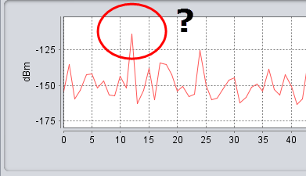
Play/Replay
In doubt of an event?
use the Play/replay feature
List of results per event
Log trace of the calculation for that event

Slide 19
Scenario/results separation - Can’t cheat the tool
Scenario and Results are separated
Set your scenario
Analyse your results
Principle of immutable variable
Can not modify scenario settings after its results are produced.

Slide 20
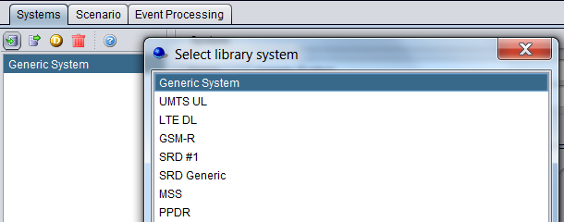
More GUI intuitive tool to work with
New GUI separate systems from the scenarios
Step 1: Prepare your systems for any present or future simulation
Step 2: Then set your scenario
Step 3: Add EPPs

Slide 21
Summary of SEAMCAT 5 features
Faster: If you have a multi-core processor computer, SEAMCAT uses all its potential
Easier : use the SEAMCAT library (antenna plugins, spectrum emission masks, propagation model plugins, etc.)
More flexible: build your own library or use existing libraries from your colleagues/organisation
Adapted for engineers - Understand what is done (debug mode) and implement or extend your algorithms
Common interface within the CEPT – Simple to share workspaces and results

Slide 22
What comes next?
SEAMCAT is continuously evolving. SEAMCAT users, including active STG members, engineers and students throughout the World are constantly providing feedback on their use of SEAMCAT. With this feedback we are able to identify which specific areas of the tool can be modified with the aim to provide them with a faster, more flexible, transparent and reliable tool.

Slide 23
Thank you - Any questions?

